Slide 1
SQL (Structured Query Language)
UNCC A.D.S

Slide 2
What is SQL?
SQL, is a programming language designed for managing and querying relational databases. It allows users to interact with databases to retrieve, manipulate, and manage data efficiently.

Slide 3
In comparison to other familiar coding languages:
- Python: While Python is a general-purpose programming language, SQL is specialized for database management. Python can be used to interact with databases using libraries like SQLAlchemy, but SQL offers more specialized syntax for database operations.
- R: R is primarily used for statistical analysis and data visualization, whereas SQL focuses on database management and querying. However, R can connect to databases and execute SQL queries for data extraction and manipulation.
- Java: Java is an object-oriented programming language used for building applications, whereas SQL is specific to managing databases. Java applications often interact with databases using JDBC (Java Database Connectivity) to execute SQL queries and manipulate data.
Overall, SQL is essential for anyone working with databases, providing a standardized language for data manipulation and management across different database platforms.

Slide 4
General Functionality and Syntax:
Basic commands such as SELECT, INSERT, UPDATE, DELETE. (Functionality is in the name)
Creating and Manipulating Tables: Defining table structures, data types, constraints, and indexes.
Retrieving Data with SELECT: Filtering, sorting, and limiting results.
Filtering Data with WHERE Clause: Using logical operators and comparison operators.
Sorting Data with ORDER BY: Sorting data in ascending or descending order.
Aggregating Data with GROUP BY: Grouping data and using aggregate functions like COUNT, SUM, AVG.
Joining Tables: Understanding different types of joins (INNER, LEFT, RIGHT, FULL) to combine data from multiple tables.

Slide 5
General Functionality and Syntax (Continued):
Subqueries: Writing subqueries to retrieve data based on the result of another query.
Modifying Data: Inserting, updating, and deleting records.
Working with Views: Creating and utilizing views to simplify complex queries.
Understanding Indexes: Creating and using indexes to improve query performance.
Managing Transactions: Using transactions to ensure data integrity and consistency.
User Access Control: Granting and revoking privileges to users.
Handling NULL Values: Dealing with NULL values in SQL queries.
Optimizing Query Performance: Various techniques can be utilized for optimizing SQL queries for better performance.

Slide 6
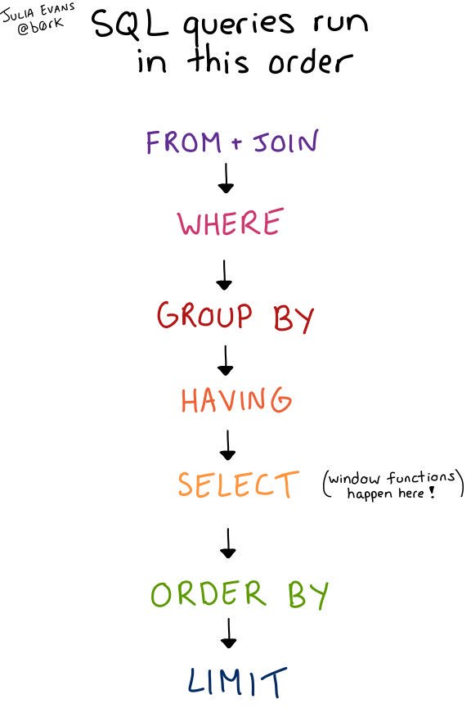

Slide 7
SQL Island Link:
https://sql-island.informatik.uni-kl.de/

